Slide 1
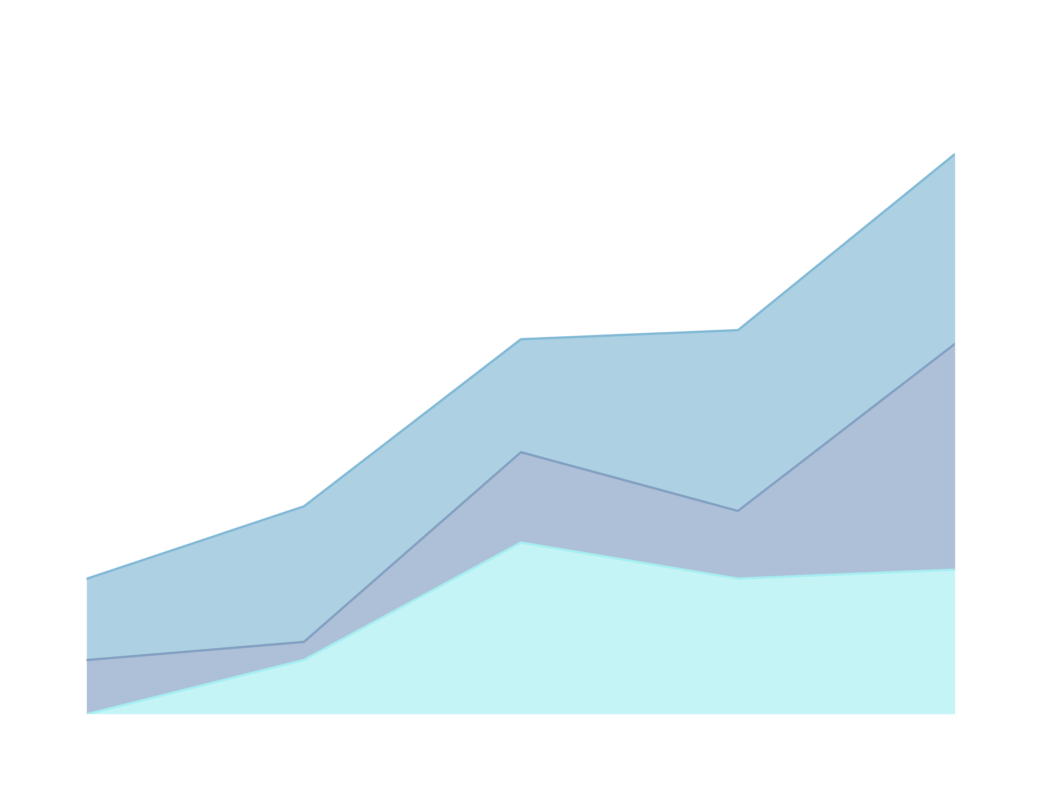
DIABETES HEALTH INDICATORS
UNDERSTANDING PATIENT PROFILES WITH FEATURES BASED ON DEMOGRAPHICS, LIFESTYLE HABITS, FAMILY HISTORY, AND CLINICAL MEASUREMENTS THAT ARE WELL-ESTABLISHED INDICATORS OF DIABETES RISK
BY : ALI IBRAHIM

Slide 2

CAUSES OF DIABETES
Our goal is to analyze diabetes as a disease through number of variables so we can produce a medical solution to this age disease.
Diabetes Types
-No Diabetes
-Prediabetes is a serious health condition that increases the risk of developing type 2 diabetes, heart disease, and stroke
-Type 1 is an autoimmune condition where the immune system attacks insulin-producing cells
-Type 2 results from a combination of genetics, lifestyle factors like inactivity and obesity, and insulin resistance
-Gestational diabetes is caused by pregnancy-related hormonal changes

Slide 3

VARIABLES AFFECTING DIABETES
DNA
SOCIAL
CLASS
GENDER
AGE
SMOKING
ALCOHOL
PHYSICAL
ACTIVITY

Slide 4

Let’s explore our dataset

Slide 5
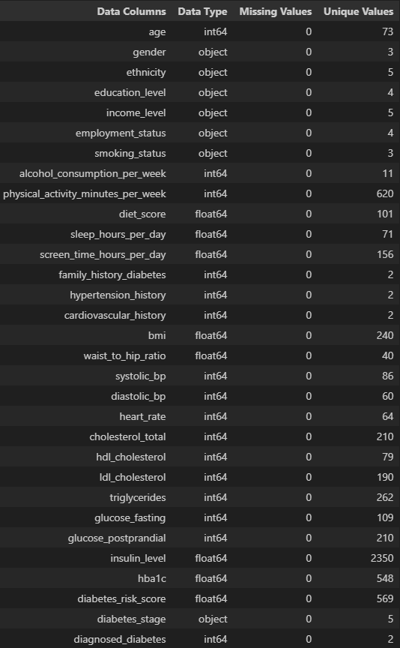
DATASET OVERVIEW
  Our dataset contains 31 features in a study involving 100,000 individuals
  No missing or duplicate data were found
All data types must be checked and validated before working

Slide 6
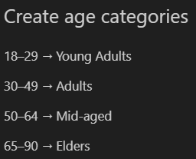
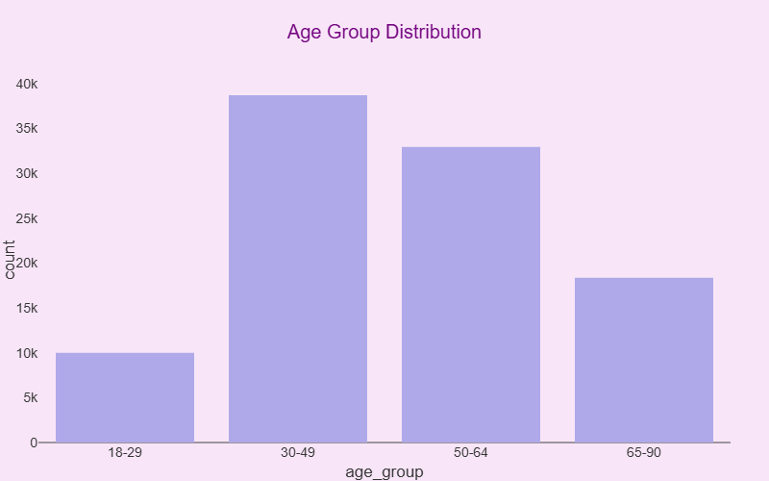
FEATURE ENGINEERING
Steps:
  Remove missing / inconsistent data → NA
  created new column : age_group
By categorizing test individuals into age groups we can notice how diabetes spread across groups

Slide 7
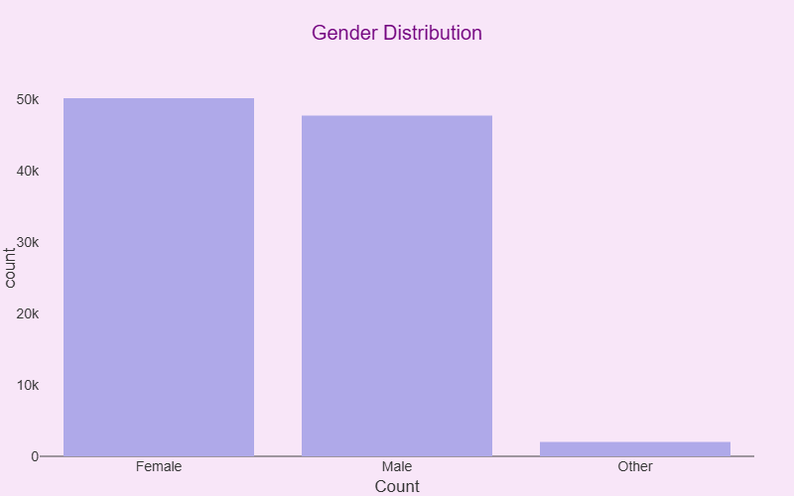
UNIVARIATE ANALYSIS
Gender Distribution in out dataset
  Female 50216
  Male 47771
  Other 2013

Slide 8
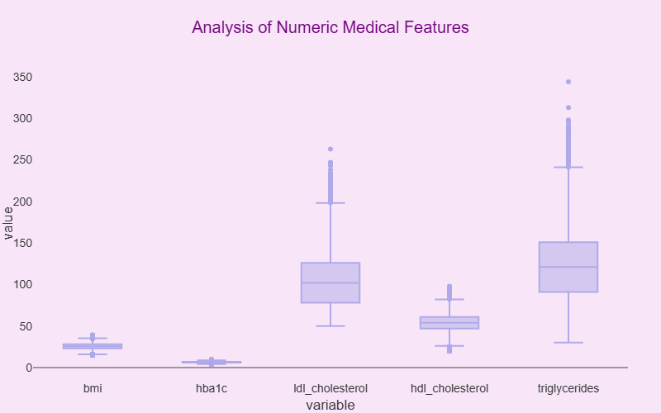
NUMERIC MEDICAL FEATURE

Slide 9
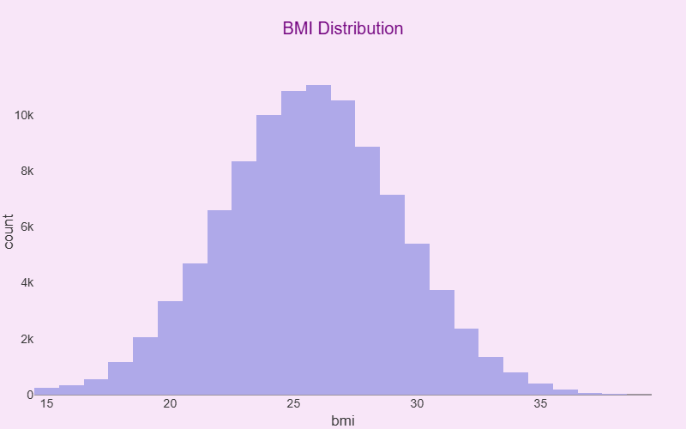
NUMERIC MEDICAL FEATURE
BMI
  Underweight: Less than 18.5
  Healthy Weight: 18.5–24.9
  Overweight: 25.0–29.9
  Obesity: 30.0 or greater

Slide 10
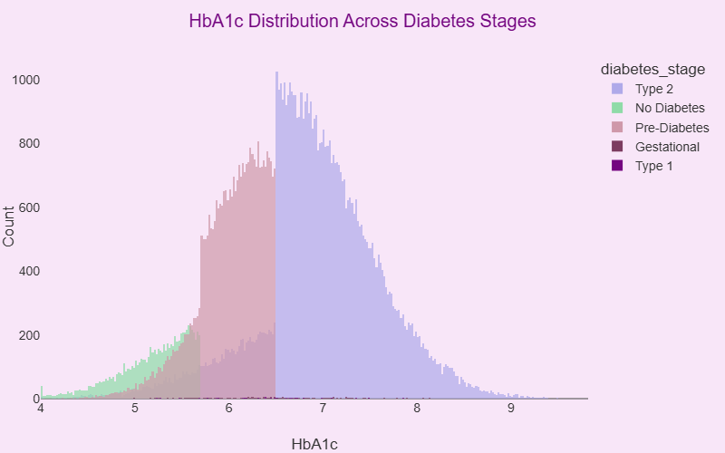
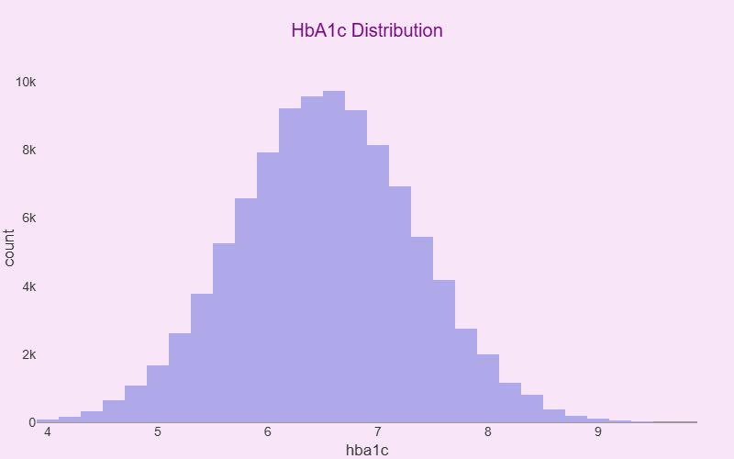
NUMERIC MEDICAL FEATURE
HbA1c measures your average blood sugar (glucose) levels over the past two to three months.
  Normal: Below 5.7
  Prediabetes 5.7 to 6.4
  Diabetes 6.5 or greater
HbA1c considered important because it tells us if the individual is at risk of diabetes

Slide 11
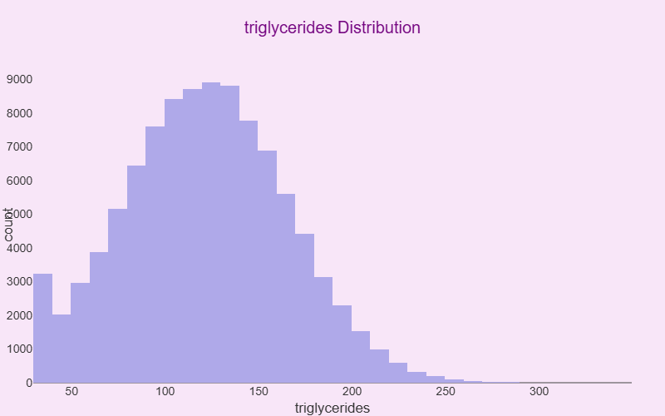
NUMERIC MEDICAL FEATURE
Triglycerides
  Ideal: Less than 150
  Borderline high: 150–199
  High: 200–499
  Very high: 500 or greater

Slide 12
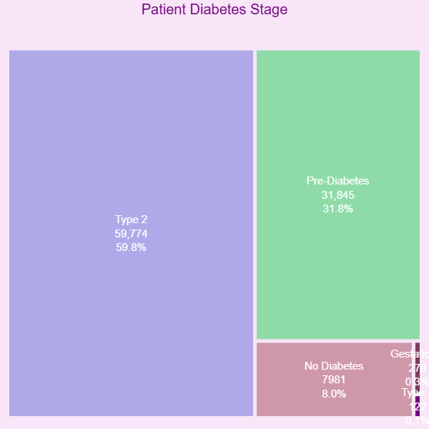
DIABETES STAGE
Pre-Diabetes is a warning sign that, if ignored, significantly increases the risk of developing full-blown type 2 diabetes
type 1 is immune disease rare condition
Gestational diabetes usually disappears after giving birth

Slide 13
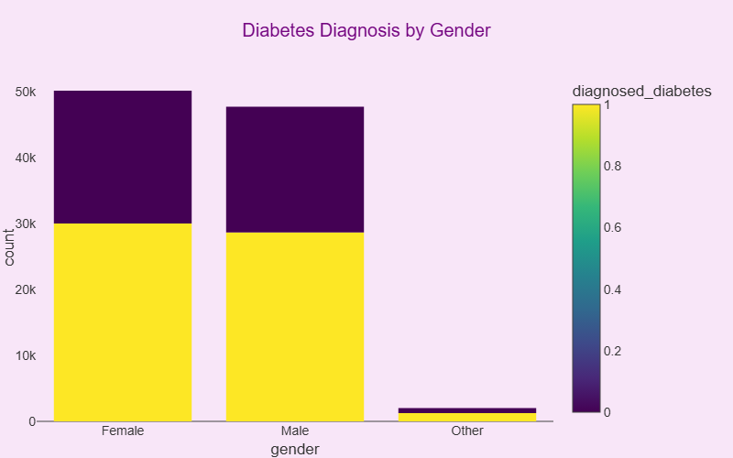
BIVARIATE
ANALYSIS
Females diagnosed with diabetes are more than males maybe due to Gestational diabetes

Slide 14
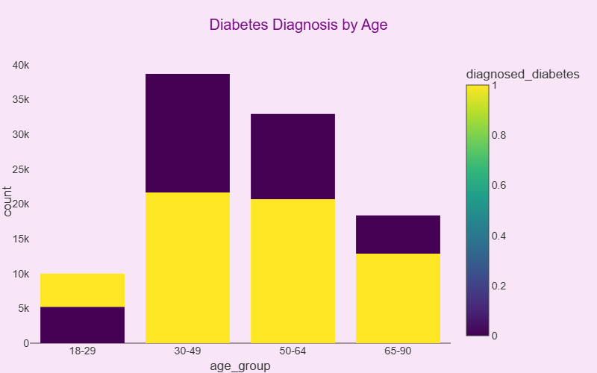
BIVARIATE
ANALYSIS
30-49 age group is most affected group due to
work / lifestyle

Slide 15
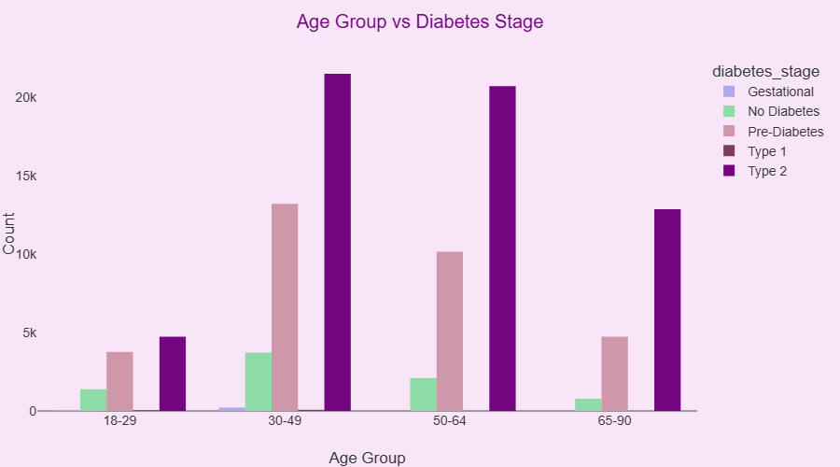
BIVARIATE
ANALYSIS
This chart solidify our argument as type 2 diabetes affected by diet and lifestyle

Slide 16
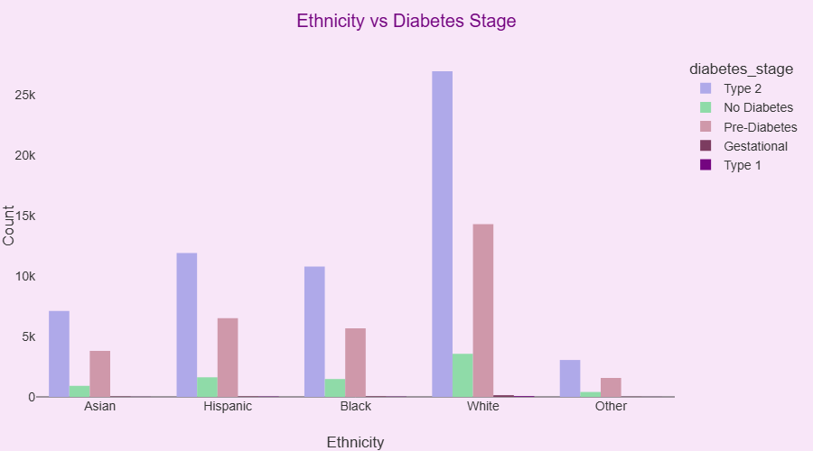
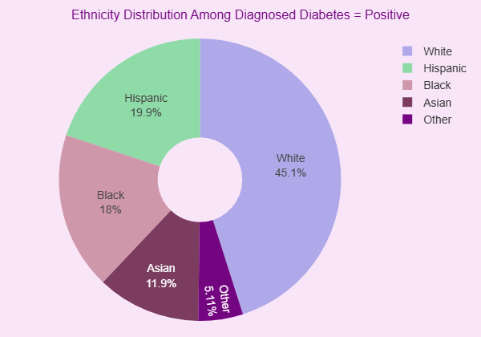
BIVARIATE
ANALYSIS
Certain ethnic groups having a higher prevalence and risk of developing type 2 diabetes

Slide 17
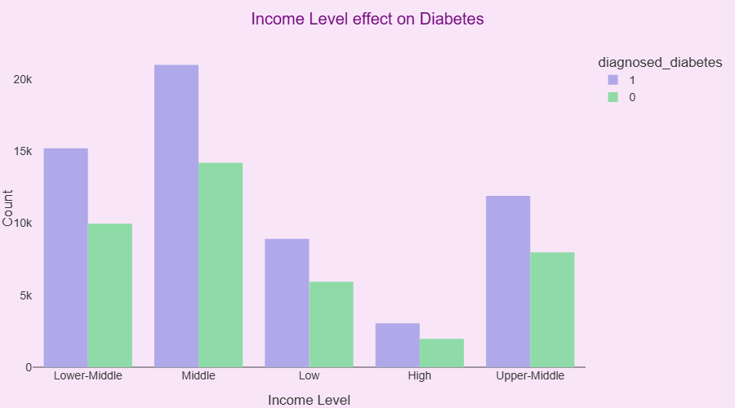
BIVARIATE
ANALYSIS
Lower income levels are consistently linked to a higher risk of developing diabetes, This association is due to several factors, including limited access to quality healthcare and healthy food, higher stress levels, and fewer opportunities for physical activity.

Slide 18
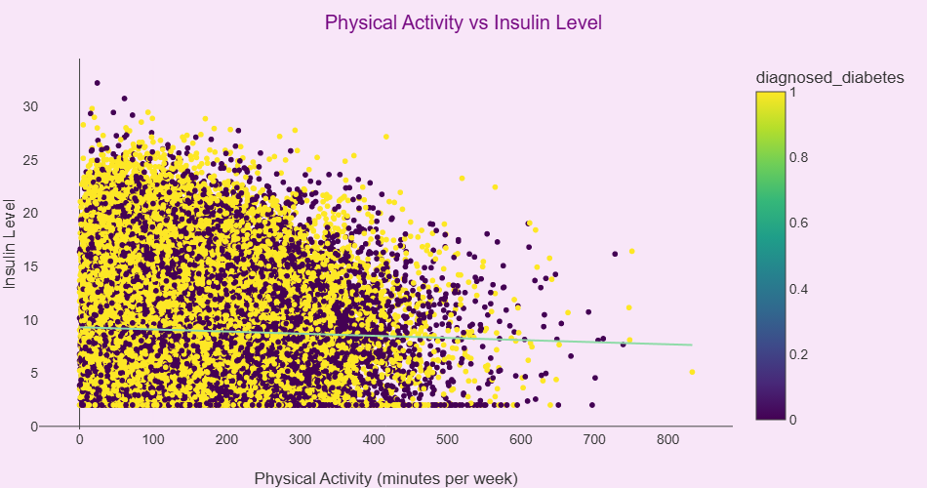
BIVARIATE
ANALYSIS
Normal insulin levels are typically between 2 and 25 𝑈/𝑚𝐿

Slide 19
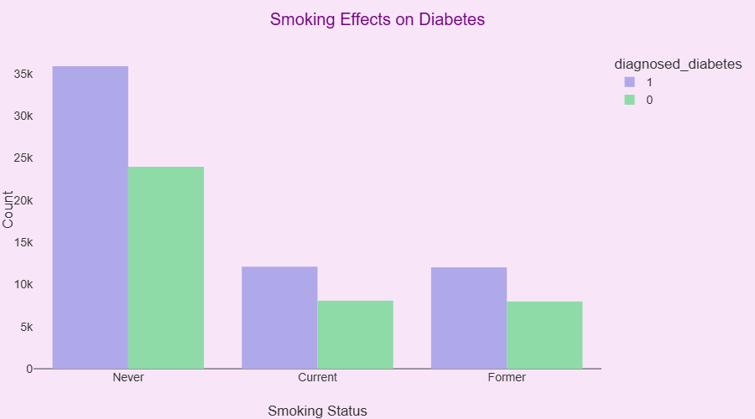
BIVARIATE
ANALYSIS
No direct relation between smoking and diabetes

Slide 20
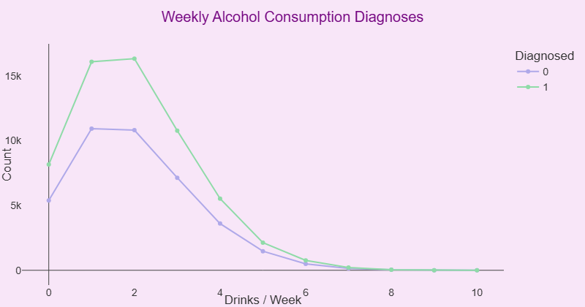
BIVARIATE
ANALYSIS
No direct relation between Alcohol Consumption and Diabetes

Slide 21
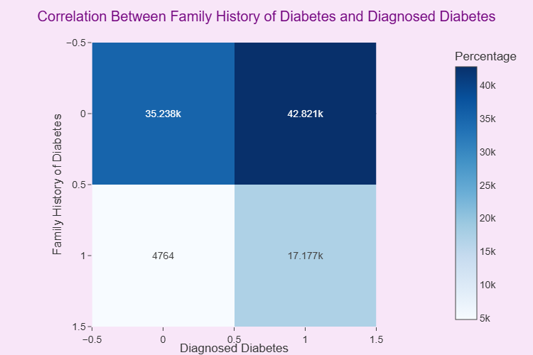
BIVARIATE
ANALYSIS
Shows there is correlation between family history and diagnosed individuals, this means some diabetes types are genetic

Slide 22
CONCLUSION
Conclusion 1 market research and data collection firm to gather consumer insights
  Lifestyle habits strongly influence diabetes progression
  Early detection is essential
  Demographic factors contribute to risk variance
  Smoking and alcohol habits remain risk accelerators
  Physical activity significantly improves diabetes outcomes
Conclusion 2 pharmaceutical company analyzing this dataset to maximize revenue opportunities,
  Geographic clustering enables market expansion
  Chronic-management products are recurring revenue streams
  Opportunities for consumable or subscription-based products
- consumables (test strips, needles, patch sensors)
- subscription health apps
4. Preventive treatment markets are highly viable
- promoting preventive therapeutics, monitoring devices, or lifestyle-linked prescriptions can generate substantial recurring revenue.

Slide 23
Thank You For Your Attention

